Slide 1

Introduction to OOP
Part 1
.Net and C#

Slide 2

.Net
A Managed application/Managed code
Bridges Programmer to low level execution
Memory Management and Garbage collection
Faster development time
Huge library of classes and code to utilise for different use cases and projects

Slide 3
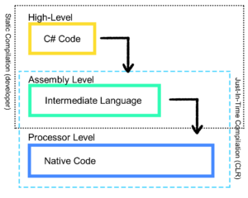
CLR and JIT
.NET works by providing a common language runtime (CLR)
This is an intermediate language between your code and the lower-level assembly language.
It allows us to program in any higher-level language which then gets converted (compiled) into the appropriate assembly language.

Slide 4
C# Language Features
Compiled Language
All code must be compiled prior to execution on the machine.
Strongly Typed
Every variable has a predefined type at compile time (unlike Python, JavaScript etc)
Designed with OOP concepts in mind
Classes, inheritance, interfacing concepts built into the language.
Businesses Use C#
In-house software solutions.
Case Sensitive
“MyVariable” is not the same as “myvariable”

Slide 5
Variables
Stored Locations in Memory
Can generally be overwritten
Defined with a specific type.
C# Examples
int myInt = 2;
string sillyString;
Definition Structure
<Type> <Identifier>;
<Type> <Identifier> = <Value>;
Identifiers
Only letters, digits and an underscore are valid characters.
Can only start with an underscore or letter.
Must be unique to its declared space.
Case Sensitive.

Slide 6
Definition Vs Use
Variable definition/declaration includes the type.
Including the type tells the compiler that it's creating a new variable:
<Type> <Identifier> = <Value>
Int specialNumber = 42;
To use the variable, you only need to use the identifier:
Console.WriteLine(specialNumber);

Slide 7
Overwriting
You can change the value of the variable be reassigning it:
Int specialNumber = 42;
specialNumber = 88;
Note that the type is not included in the second statement.
By omitting the type, you are pointing to the previous declaration and changing the value.

Slide 8
Types
Below is a table of some variable types you can use in C#
Type | Keyword | Example
Int | int | 6
Boolean | bool | true
Float | float | 3.14f
Double | double | 1.57d
String | string | “Hello World”

Slide 9
Keywords
There are 77 reserved Keywords in C# that cannot be used in naming as they have a purpose. Some of which have been mentioned already (int/bool etc).
Find some other words that are reserved and add them below:

Slide 10
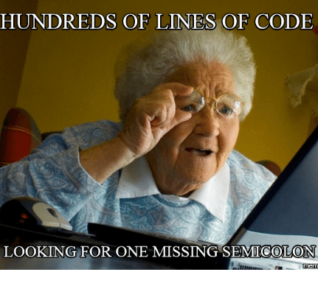
Statements
C# is made up of statements which always end with a semicolon “;”
You will forget a semicolon… lots.
Thankfully as C# is compiled, you should easily find the issue through debugging.
Console.Writeline(“Hello World”);

Slide 11
Comments
Comments in code are either information and notes for the developers or in development sometimes used to remove a line or multiple lines that are temporarily not needed.
Single line comments are achieved using // Everything after this will be commented out and not executed by the program.
Multiline comments are done using /* symbols. Unlike multiline, this requires closing using */ Similar to how HTML uses opening and closing tags.

